Slide 1

Predicting Marketing Campaign Response Using EDA, PCA and Gradient-Descent-Based Logistic Regression
Summer Internship- 2026
Name: Udita
Supervisor: Prof. Millie Pant
Mentor: : Ms. Riya & Mr. Harjeet Applied Mathematics & Scientific Computing
Indian Institute of Technology Roorkee

Slide 2

Contents
Introduction
PCA
Gradient Descent
Objectives
Dataset & EDA
Data Preprocessing
Data set
Reference

Slide 3
Introduction
Marketing teams run costly campaigns, but only a fraction of customers respond — identifying likely responders in advance improves ROI and cuts wasted spend.
This project analyzes a customer marketing dataset covering demographics, spending habits, purchase channels, and past campaign responses.
Goal: build an end-to-end pipeline — from raw data to a working predictive model — combining exploratory analysis, dimensionality reduction, and classification.
Scope: EDA & preprocessing, PCA, Logistic Regression classification, and a from-scratch study of Gradient Descent optimizers.
2,240
customer records
29
raw attributes
1

Slide 4
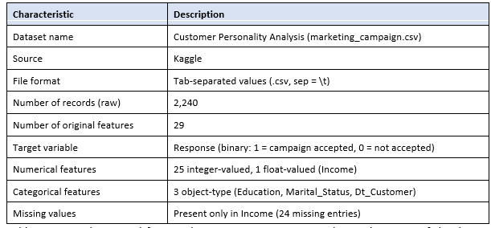
Data Set
2

Slide 5
Objectives
The objective is Customer Response Prediction for Targeted Marketing
Analyze customer demographics and purchase behavior using the Customer Personality Analysis dataset.
Perform data preprocessing and Exploratory Data Analysis (EDA) to prepare high-quality data for modeling.
Apply feature engineering and Principal Component Analysis (PCA) to improve data representation and reduce dimensionality.
Study and compare the performance of Batch Gradient Descent, Stochastic Gradient Descent (SGD), and Mini-Batch Gradient Descent.
Implement SGD from scratch and validate its performance by comparing it with scikit-learn’s
Evaluate the impact of learning rate and batch size on convergence to develop an efficient machine learning pipeline.
3

Slide 6
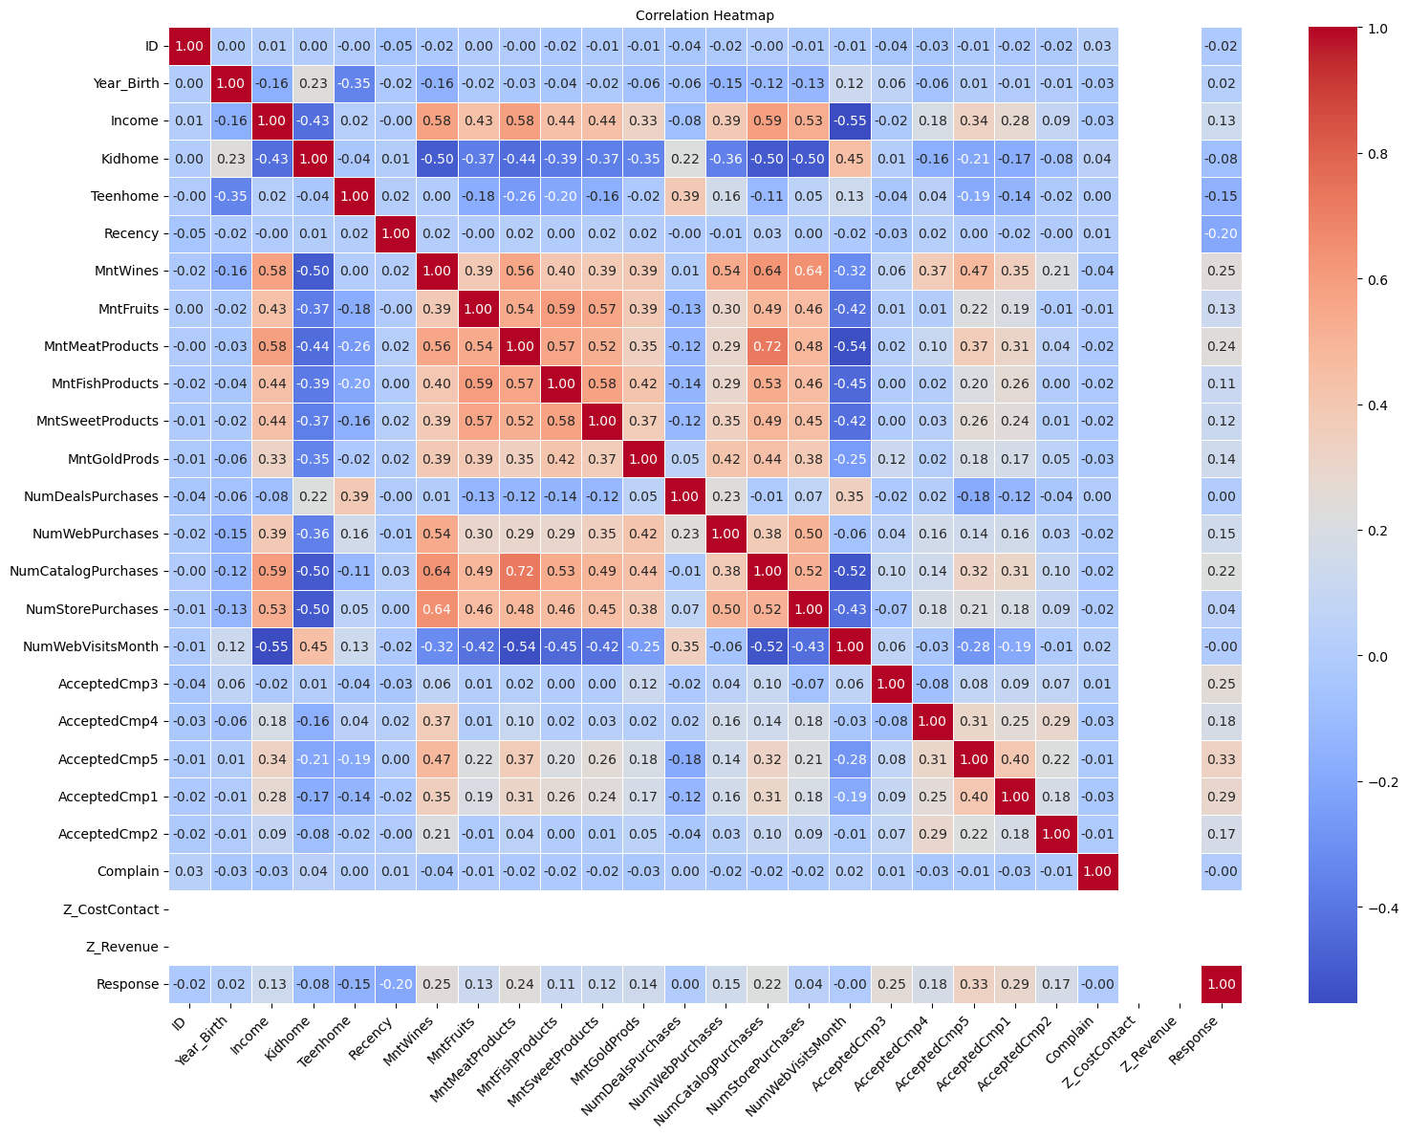
Dataset & Exploratory Data Analysis
2,240 customer records with 29 attributes: demographics, spend across product categories, purchase channels, and campaign-acceptance history.
Income had 24 missing values; distributions were reviewed using histograms and boxplots across all numerical columns.
A correlation heatmap reveals moderate positive relationships among purchase-related variables (wine and meat spend, store and web purchases), while most other features show weak correlation.
Pair plots of top features helped visualize relationships between income and spending behaviour.
4

Slide 7

Data Preprocessing
Missing Income values imputed with the median; missing categorical values imputed with the mode.
Education and Marital_Status one-hot encoded.
Numeric features standardized (StandardScaler); MinMaxScaler compared for reference.
Outliers removed using a Z-score threshold (|z| < 3): dataset reduced from 2,240 to 1,592 records.
Dt_Customer converted into a new engineered feature, Customer_Tenure_Days.
Data split into training (1,273) and test (319) sets — an 80/20 split.
5

Slide 8
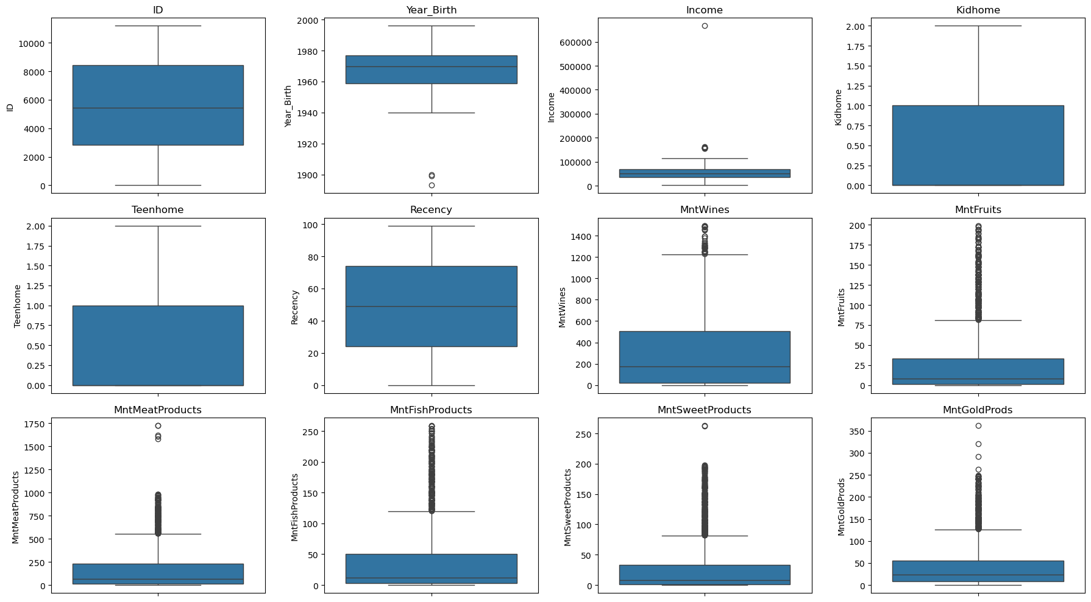
Outlier detection across numerical features (IQR / boxplots)
6

Slide 9
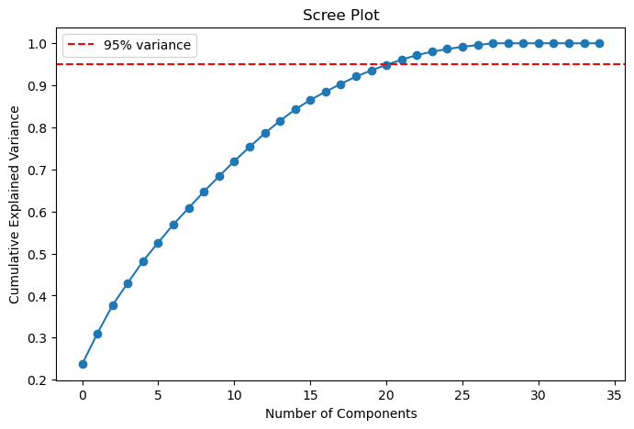
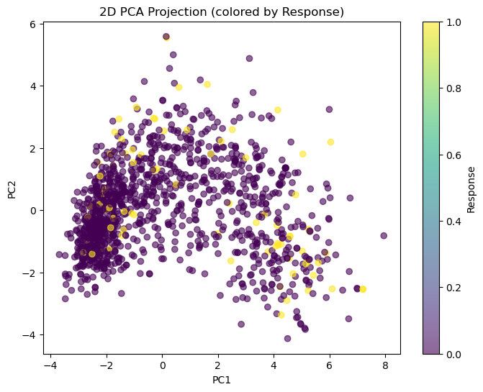
Dimensionality Reduction with PCA
Standardized features (35 dimensions after encoding) were fed into PCA.
The scree plot shows 22 components are needed to retain 95% of the variance — roughly a 37% reduction in dimensionality.
A 2D projection of the first two components visualizes separation between responders and non-responders.
A loadings heatmap highlights which original features contribute most to each principal component.
7

Slide 10
Predictive Modeling — Logistic Regression
Logistic Regression was trained twice: once on all 35 scaled features, and once on the 22 PCA components.
PCA cut the feature space by ~37% with only a 0.3 percentage-point drop in accuracy — a strong trade-off for a simpler, faster model.
91.2%
Accuracy — original 35 features
90.9%
Accuracy — 22 PCA components
8

Slide 11
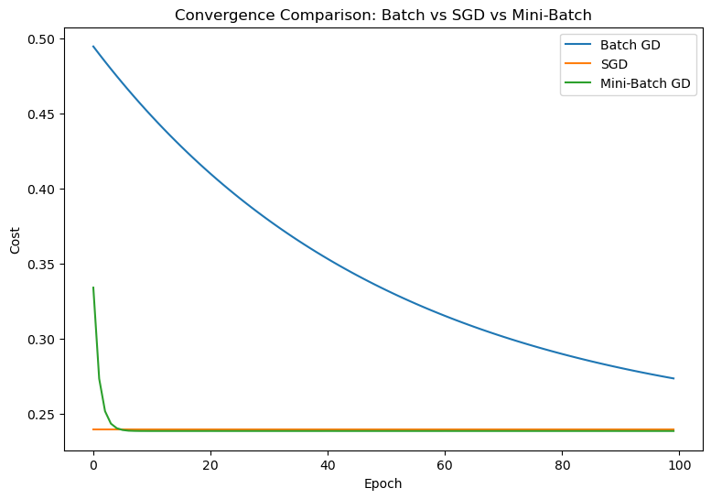
Gradient Descent Optimization — From Scratch
Implemented Batch, Stochastic (SGD), and Mini-Batch Gradient Descent from scratch to fit a simple linear model (Income → MntWines).
Batch GD is smooth but makes slower per-epoch progress; SGD is noisier but often converges faster in wall-clock time; Mini-Batch balances both.
Also studied the effect of learning rate and batch size on convergence stability.
The custom SGD implementation closely matched scikit-learn's SGDRegressor coefficients, validating the from-scratch code.
9

Slide 12
Key Results & Conclusion
EDA confirmed a largely clean dataset with moderate correlations among purchase-related features — suitable for machine learning after preprocessing.
Preprocessing (imputation, encoding, scaling, outlier removal) improved data quality, yielding 1,592 well-conditioned records.
PCA compressed 35 features into 22 components while retaining 95% of the variance.
Logistic Regression achieved ~91% accuracy in predicting campaign response; PCA-reduced features performed nearly as well as the full feature set.
Mini-Batch Gradient Descent offered the best balance of convergence speed and stability among the three optimizers studied.
10

Slide 13
References
Dataset: “Customer Personality Analysis / Marketing Campaign Data”, Kaggle.
Pedregosa, F. et al. “Scikit-learn: Machine Learning in Python.” Journal of Machine Learning Research, 2011.
Hunter, J. D. “Matplotlib: A 2D Graphics Environment.” Computing in Science & Engineering, 2007.
Waskom, M. “seaborn: Statistical Data Visualization.” Journal of Open Source Software, 2021.
McKinney, W. “Data Structures for Statistical Computing in Python.” Proc. of the 9th Python in Science Conf., 2010.
Jolliffe, I. T. “Principal Component Analysis.” Springer Series in Statistics, 2002.
11

